Slide 1

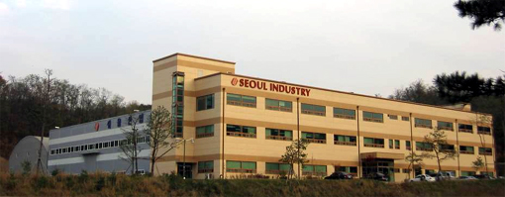
Year 2013
Integrated Precision Machining Supplier
In Global Automotive industry
Phone : +82-31-366-1141~7 Fax : +82-31-366-1150 E-mail : sales@seoulind.co.kr #1004-1, Shinwang-ri, Yanggam-myun, Hwasung-shi, Kyonggi-do, Korea
TS 16949 ISO 14001
Notes:
We welcome your visiting and Thank you for sharing your time to listen to our presentation.
from now on, i‘m going to introduce our company.
Our vision is to be a Integrated Precision Machining Supplier in Global Automotive Industry. This is our target.
This yellow building is office buliding. In the first floor there are inspection room, tooling room. Second floor left side is office
Right side is cafeteria, Third floor is President room, fitness center and dormitory.
Gray building is plant building. Production line in the middle area and in the end warehouse.

Slide 2
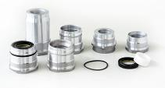


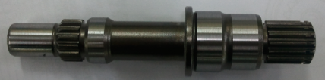
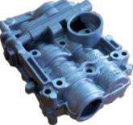
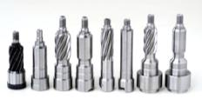



목 차
1. | 운영 목표 | - - - - - - - - - - - - - - - - - - - - | 3
2. | 회사 프로파일 | - - - - - - - - - - - - - - - - - - - - | 4
3. | 회사 연혁 | - - - - - - - - - - - - - - - - - - - - | 5
4. | 조직도 | - - - - - - - - - - - - - - - - - - - - | 6
5. | 주요고객 | - - - - - - - - - - - - - - - - - - - - | 7
6. | 년간 매출 현황 | - - - - - - - - - - - - - - - - - - - - | 8
7. | 주요 생산 라인 & 주요 생산 제품 | - - - - - - - - - - - - - - - - - - - - | 9
8. | 신규 개발 프로그램 | - - - - - - - - - - - - - - - - - - - - | 17
9. | 개발 역량 | - - - - - - - - - - - - - - - - - - - - | 18
10. | 품질보증 장비 | - - - - - - - - - - - - - - - - - - - - | 19
11. | 품질 인증서 | - - - - - - - - - - - - - - - - - - - - | 22
Notes:
.

Slide 3
1. 운영 목표
글로벌 자동차 산업의 통합적 정밀 가공 공급
통합적 가공
가격 경쟁력
진보된 기술개발
품질 시스템 강화
Turning
Facing
Milling
Broaching
Drilling
Heat treatment
Grinding
Burnishing
Hobbing
Skiving
Polishing
…
자동화 생산 라인
최적화된 공정
탄력적 공정시스템
SCM 관리(공급망)
소재,부품 개발
공정 개발
APQP
기술 협의
글로벌 표준
TS16949
ISO14001
SQ Mark
고객 만족 품질관리
Poke Yoke 시스템
Notes:
Integrated Precision Machining Supplier mean Our machining parts are mad by such as Turning, Facing, Milling, Broaching, Drilling, Heat treatment(it is out sourcing), and Grinding, Burnishing, Hobbing, Skiving, Polishing and other machining process.
To achieve our goal, we are improving cost competitiveness through Automated production line, Optimized Processes, Alternative process and SCM control.
We are advancing R&D capability, even we are machining supplier, We need to understand about material, heat treatment and other out sourcing process controls.
We have quality system Global standard TS16949 ISO14001 and SQ Mark for Hyundai and Kia motor.
2

Slide 4
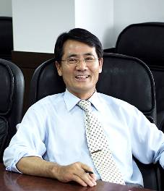
2. 회사 프로파일
설립일: 1985년 5월 20일
운영기간: 28년
사훈: 화합, 창조
주소 : 경기도 화성시 양감면 신왕리 1004-1번지
전화 : +82-31-366-1141~7
팩스 : +82-31-366-1150
Home page : www.seoulind.co.kr
E-mail : sales@seoulind.co.kr
자본금: 16억
DUNS Number : 68-871-9392
사원수: 185명
2011년 매출액: 457억
2012년 매출액: 513억
대지 : 2,120 ㎡ (7,000 평), 건평 : 700㎡ (2,000평)
We are trying to be
the best supplier for customer’s satisfaction
at precision machining automotive industry.
대표이사 김을식
Notes:
We was established in 1985 so it’s over 28years. And our business motto is Harmony & Creation. We are located in Hwasng city. The South area from Seoul Korea capital and international airport. Our capital is 1.5 Mil dollars, total employees are 185 people. About 40 for management and the balance for production.
And our last years sales revenue was 46milion dollars and this year we are expecting about 55 million dollars, which is due to mainly the new programs for Overseas. Our land space is 250 thousand square feet and 100 thousand for plant space.
3

Slide 5
3. 회사 연혁
1985 | “서울정밀“설립
1987 | 한국 TRW (TSCL) 공급자 등록 공급시작
2001 | QS9000 / ISO9002 인증 획득
2002 | 한국 Delphi 공급자 등록 공급시작
2003 | TRW A/P 구매로부터 감사패 수여
2003 | 일본 TRW 공급자 등록 공급시작
2004 | 북미 TRW 공급자 등록 공급시작
2004 | ISO / TS16949 인증 획득
2004 | 북미 & 한국 METALDYNE 공급자 등록 공급시작
2006 | 현 부지로 확장 이전Plant moving (250,000sq.ft size land / 10,000sq.ft size building)
2007 | 중국 NEXTEER 공급자 등록 공급시작
2008 | 북미, 중국,독일 Thyssen Krupp 공급자 등록 공급시작
2008 | Magna Powertrain공급자 등록 공급시작
2009 | STT 공급자 등록 공급시작
2009 | 현대모비스 공급자 등록 공급시작
2011 | 100억 수출 진흥상 수여 (한국 무역협회)
Notes:
As I told, We started in 1985. and fist customer was TRW Korea. and in 2002 Korea Delphi
and we Started to extend our business to oversea area from 2003 to TRW Japan and TRW North America and Metaldyne in USA & Korea. In 2007 Nexteer china, In 2008 Magna Powertrain. In 2009 STT and Hyundai Mobis, and this year magna family companies in Canada and your company GKN .
4

Slide 6
4. 조직도
대표이사
공장장
생산이사
재무관리 이사
생산팀
국내영업팀
공무팀
개발팀
해외영업팀
품질팀
경리팀
구매팀
생산관리팀
물자반
R&D
물자반
품질보증
생산기술팀
관리팀
측정실
공구실
총 사원수: 185명
관리인원 40명 / 장비운용 및 기타 145명
Notes:
Next, I will briefly talk about the workplaces of this company.
Our main office and factory are located in here WhaSung city.
Here are 185 staff including President, Plant manager, Production team, Sales team, Maintenance, R&D, Q.C. finance, purchasing and management.

Slide 7
5. 주요고객
Div. | Customer | Region
해외 | Thyssen Krupp | US, China, Germany
 | Magna – New Venture gear, UMG, APT, Pullmatic | Canada, Mexico
 | STT | Canada
 | Metaldyne | US
 | Spartan | US
 | TRW | Japan
 | Nexteer | China
국내 | Metaldyne Korea
 | TRW Korea
 | Korea Delphi
 | Hyundai Mobis
 | MyungHwa
Customers portfolio (2012)
Notes:
These are our current customer table. We are supplying to Steering field, Engine field and Transmission field.
In Grobal market Thyssen Krupp companies, Magna group companies, Metaldyne, Spartan, TRW and Nexteer
In domestic market Metaldyne Korea ,TRW Korea, Korea Delphi, Hyundai Mobis and MyungHwa
The portion of global market is 30% and Domestic market is 70%

Slide 8
6. 매출현황
260억
220억
320억
450억
510억
610억
Notes:
This is our achievements.
This year we are going to supply mass production PO for 6 new programs, including 4 global program and 2 domestic programs.
We could acquire this achievements through long term engineering know-how and high and improving quality level, with this, our company is still growing year by year.

Slide 9
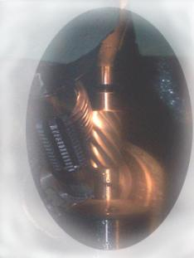
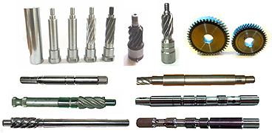

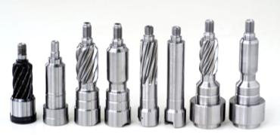

7. 주요생산 라인 및 주요 생산품
Pinion shaft assembly
TRW, Mobis, Nexteer, KDAC
단조
CNC 가공
MCT 가공
전조
호빙
고주파열처리
하드호빙 스카이빙
조립
호빙
스카이빙
Steering - Pinion Shaft assembly
Over 100 different part numbers for all major Steering system suppliers in Korea
Notes:
From this page, Main production line and products
First Pinion shaft which is supplied to TRW, Mobis, Nexteer and Korea Delphi
And process is forging. Turning, machining, rolling, hobbing, Carburizing or Induction hardening, hard hobbing and shyving
We have over 20 year experience for this kind of part and We are producing various types of Pinion shafts according to customers need as shown here in this pictures.
In past, we did machining process with bar stock material but we developed to use forging process to Minimize machining process and saved cost and then we had applied to all customers and related parts.
5

Slide 10
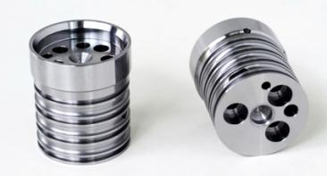
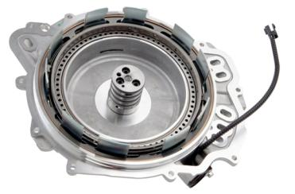
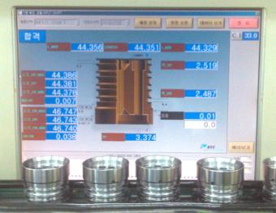
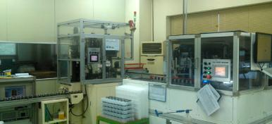
7. 주요생산 라인 및 주요 생산품
Input shaft Hub for 6speed auto transmission
Metaldyne , Spartan for GM/Ford X22F
열처리
CNC 가공
MCT 드릴
밀링
버니싱
디버링
초음파 세척
100% 자동검사Poke yoke
End cover assembly at customer
Auto inspection data
Auto inspection & Poke yoke
Over 1.2Mil pcs/year for X22F 6speed auto transmission of GM/Ford
Notes:
Input shaft consists of Turning, drilling, side end milling, burnishing, deburring and washing
And we are doing 100% auto inspection and Poke yoke. There are system for customer’s important dimension checking and distinguishing different parts
6

Slide 11
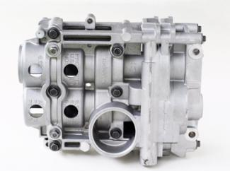
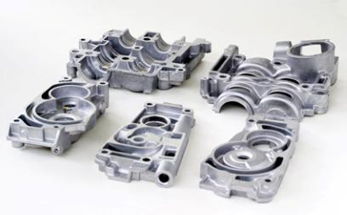
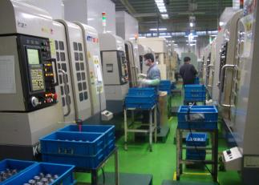
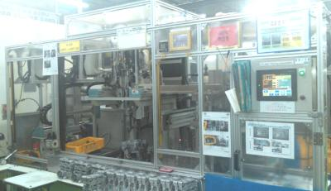
7. 주요생산 라인 및 주요 생산품
Balance shafts module housing
Metaldyne, MyungHwa for HMC
Al. 다이캐스팅 (A380)
Component MCT 가공
하우징 조립
조립품 가공
세척
자동검사
Machining line
Assembly Line
For Hyundai Motors major application / Over 3.5Mil pcs a year
Notes:
And Balance shafts module Housings. Upper housing, Lower housing and Housing 1 2 3 assembly is supplied to Metaldyne Korea and end user is Hyundai Motors.
These die casting are supplied from customer side and we are doing machining, assembly, washing and packing process.
6

Slide 12

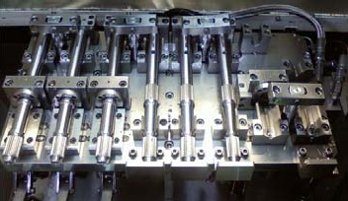
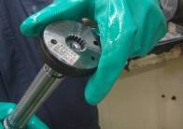
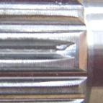
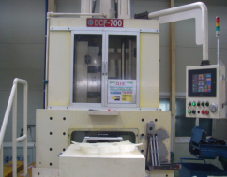
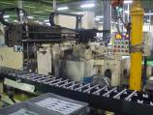
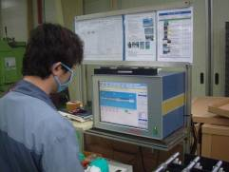
7. 주요생산 라인 및 주요 생산품
Actuator shaft
Magna – New Venture gear / Ramos
환봉소재
CNC 가공
전조
MCT 가공
자동검사
세척 및 포장
연마
MCT Machining
Blocked teeth
Spline control
Gear Roll Forming M/C
Grinding
Auto inspection
VAVE new process for double teeth
Notes:
Actuator shaft for Magna power train, when we received RFQ, old process for Spline was machining type. but we suggested and developed rolling process instead of machining.
And those were accepted. And so It could save cost. Now we are doing business over 5 years with them. And they gave many chance to attend their inquiry. And now we are supplying to 5 magna group companies and we have growing relationship with them.
6

Slide 13
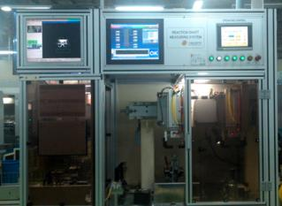
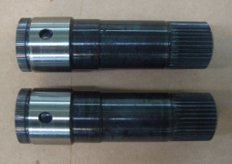


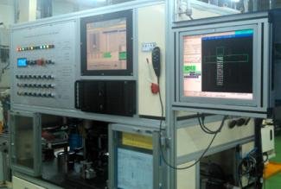
7. 주요생산 라인 및 주요 생산품
GF6 Gen II Pump shafts – Gen II SD, HD
STT
단조
CNC 가공
전조
드릴
호빙
고주파열처리
100% 자동검사Poke yoke
연마
Gen II
Gen III
HD Auto inspection
SD Auto inspection
Gen III PPAP – Nov. 2012.
PPAP 승인직후 양산 시작 예정
2분기 이후 공급 현황 양호
Gen2, Gen3 라인 탄력적인 전환
Exclusive production line for Gen II & Gen III over 1Mil capacity
Notes:
GF6 Pump shafts to Magna-STT. There are GEN II and GEN lll program. these are runing change program and at the same time, volume is increased.

Slide 14
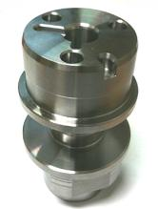
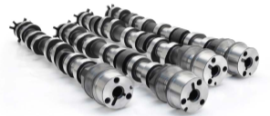
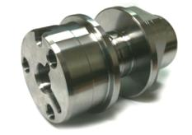
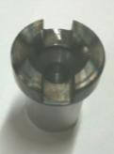
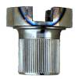
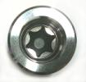
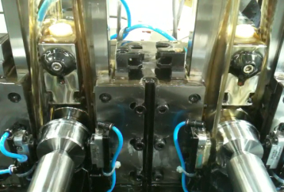
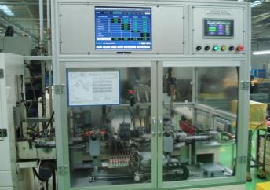
7. 주요생산 라인 및 주요 생산품
End pieces
Thyssen Krupp Presta
환봉소재
CNC 가공
전조
MCT
가공
자동검사
세척 및 포장
Customer Camshaft assy
Exclusive broaching process
100% auto inspection
Exclusive production line over 1Mil capacity
Notes:
End pieces to Thyssen Krupp, located in USA, China and Germany.
This year, They are purchasing more 15% than last year.

Slide 15
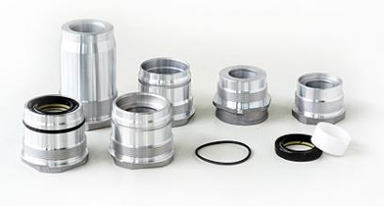
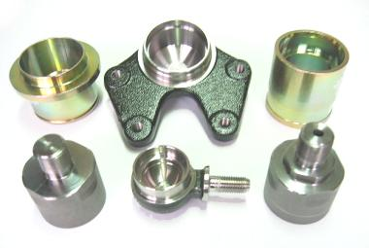
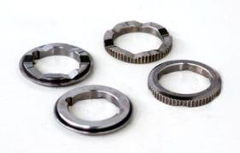
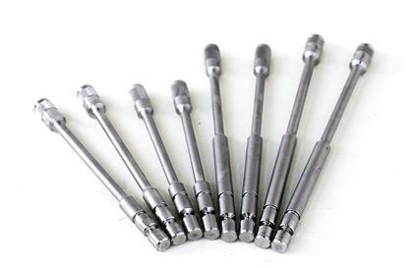
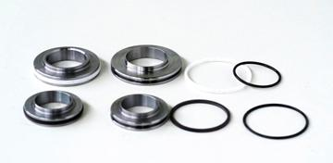
7. 주요생산 라인 및 주요 생산품
Torsion bar, Rack bush, Piston, Reaction plate
TRW, KDAC, Mobis
다이캐스팅 소결
Shot peening
연마
조립
세척 및 포장
CNC 가공
Steering assembly components / Preparing assembly parts supplying
Notes:
Torsion bar, Rack Bush, Piston which is supplied to TRW, Korea Delphi and Mobis.

Slide 16
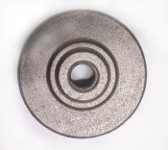
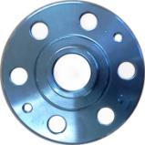
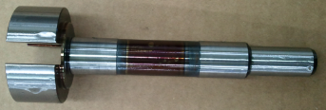
7. 주요생산 라인 및 주요 생산품– 신규 양산
Magna – APT Gen V pump shaft
Magna – UMG Lada Hub
양산
양산
냉간 단조
CNC 가공
고주파 열처리
MCT 가공
연마 / 폴리싱
단조
CNC 가공
MCT 가공
마킹
세척
열처리
Precision surface finishing
End user – Avtovaz in Russia
Notes:
New Launch programs
Magna – UMG Hub for Lada in Rusia, We successfully launched this program from the last year and we received high score in quality and delivery.
Magna – APT Gen V pump shaft for GM Canada, even though we are supplying parts from this year, recently customer suggested 80% volume increase.
And we are discussing about that.

Slide 17


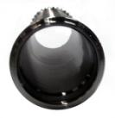
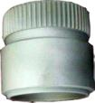
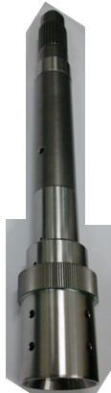



8. 신규 개발 프로그램
X26R - Pump shafts
Transmission clutch module – Output shaft
Short shaft process
소재 SAE513
1,2차 CNC 가공
호빙
3차 CNC 가공
FNC질화
열처리
SOP - TBD
Spartan in IL. US SOP – 2013 GM Toledo, OH
Notes:
New development programs
X26R - Pump shafts and Output shaft for GM Program

Slide 18
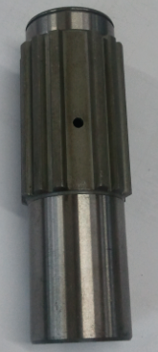
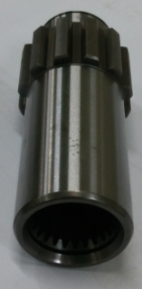
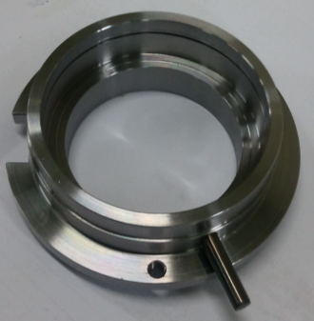
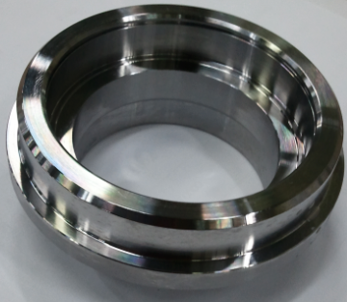
8. 신규 개발 프로그램
EM5W-7, EM8B HUB
EM5W-7, EM8B COREFIELD
Hub Process
Core field Process
SCM415H 냉간단조
호빙
드릴 - 세척
침탄
연마
CNC 가공
S10C 열간단조
슬로팅-드릴
핀 조립
CNC가공
Notes:
As you know this is new program for your company.
Thank you for giving us this program and We hope we can successfully launch this program and have continuous growing business relationship with you from starting this program.

Slide 19

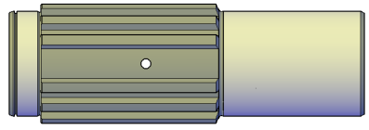





9. 개발 역량
Material
Simulation
3D modeling
Process
Exclusive M/C
Tooling design
Validation
IPA validation test
GD&T
Specification
Forging
Heat treatment
Heat Treatment
- QT.
- Induction hardening
- Carburizing
- FNC
Forged spline
3D modeling
Steering pinion shaft assy validation test
Hob regrinding
Universal tester
Notes:
R&D capability,
Our R&D Team understand material, forging and heat treatment and other out sourcing process controls
And GD&T and exclusive machine and tool design and validation test.

Slide 20








10-1. 측정 설비– GD&T
3차원 측정기 (X2)
자동기어측정기
동심도 측정기
조도측정기
측정실 전경
위상각 측정기
윤곽도 측정기
Notes:
Here we can see Seoul Industry’s measuring equipments. CMM, gear measuring machine for pinion shaft, gear and also hobe cutter, Run out gage, phase angle inspection machine, roughness tester and profile measuring equipment.

Slide 21







10-2. 측정 설비– Metallurgical, Etc.
마이크로 비커스 측정기
청정도 측정기
폴리싱기
로크웰 경도 측정기
측정실 전경
Inspection equipment
Q’ty
Inspection equipment
Q’ty
CNC gear measuring M/C / manual type
1/1
CMM
2
Contour Measuring M/C (surface finish tester)
1
Rockwell hardness tester
1
Projection projector
2
Roughness tester
3
Magnetic particle detector
1
Circularity Inspection M/C
1
Micro Vickers tester
1
Universal tester
1
Notes:
And Micro Vickers, cleanliness tester and polishing equipment

Slide 22









10-3. 자동검사기
Input shaft hub
Coyote End pieces
Intermediate shaft
GF6 Double teeth inspection
GF6 shafts
Actuator shafts
Pinion shaft auto straightness adjuster
Grinding parts auto gage
Secure more reliable quality
Notes:
These are full automatic measuring machines in production line. We have auto inspection machines for Input shaft, end piece, intermediate shaft, GF6 Shaft and Autuator shaft
those are customized for material character. So, we can minimize human errors and we can keep high quality levels.
So, customers trust our improving quality activity and giving new program and repeated volume increase.

Slide 23





11. 품질 인증서
ISO/TS16949
ISO14001
Global Standard Quality System
Notes:
This is certificates, thank you for listening our presentation

